Slide 1
Pulse Shape and Signal Processing for Neutron and Gamma Energy Sources
Nathan Barba Mentor: Dr. Craig Hardgrove Arizona State University Mechanical Engineering

Slide 2
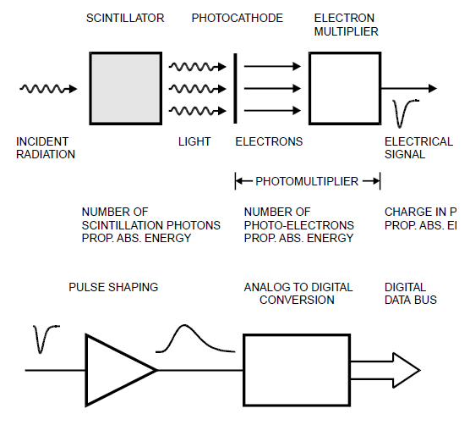
Neutron Spectroscopy Using CLYC
Cs₂LiYCl₆:Ce (CLYC) is an inorganic scintillator that has dual sensitivity to neutron and gamma rays.
Scintillation detectors produce light when exposed radiation.
The light generated is converted to electrical energy using a photomultiplier tube (PMT). The waveform signals that are output from the PMT are called pulses.
The signal from the pulses can be pre-processed using analog and/or digital electronics.
Source: Spieler, H., Front-End Electronics and Signal Processing

Slide 3
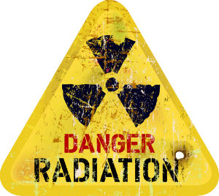
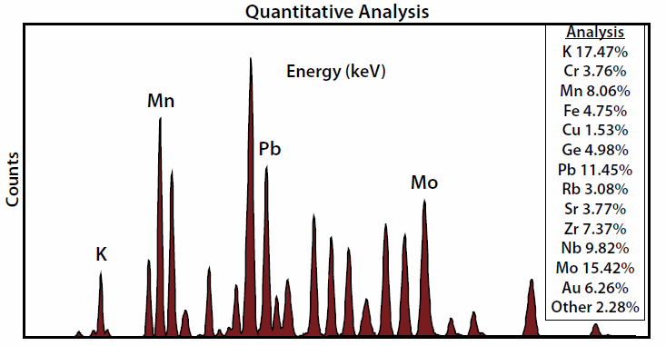
Applications
Radioactive Material Detection
Quantitative Analysis
Soil composition
Oil and Gas
Hydrogen Detection
Space applications
Source: Amptek

Slide 4
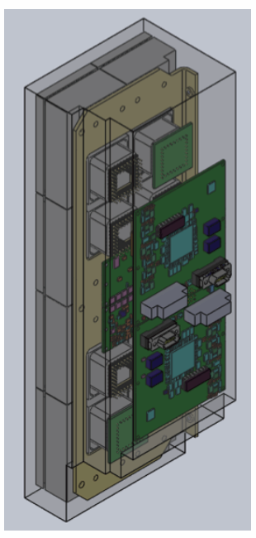
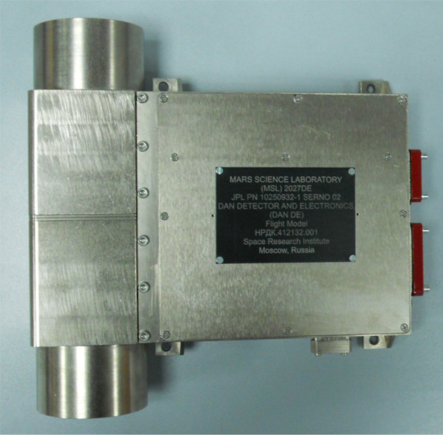
Space Based Neutron Detectors
LunaH-Map
MiniNS Detector
Mars Science Laboratory (Curiosity)
Dynamic Albedo of Neutrons (DAN)
DAWN Mission
Gamma Ray and Neutron Detector (GRaND)
MiniNS Source: Hardgrove Labs
DAN Instrument Source: ROSCOSMOS

Slide 5
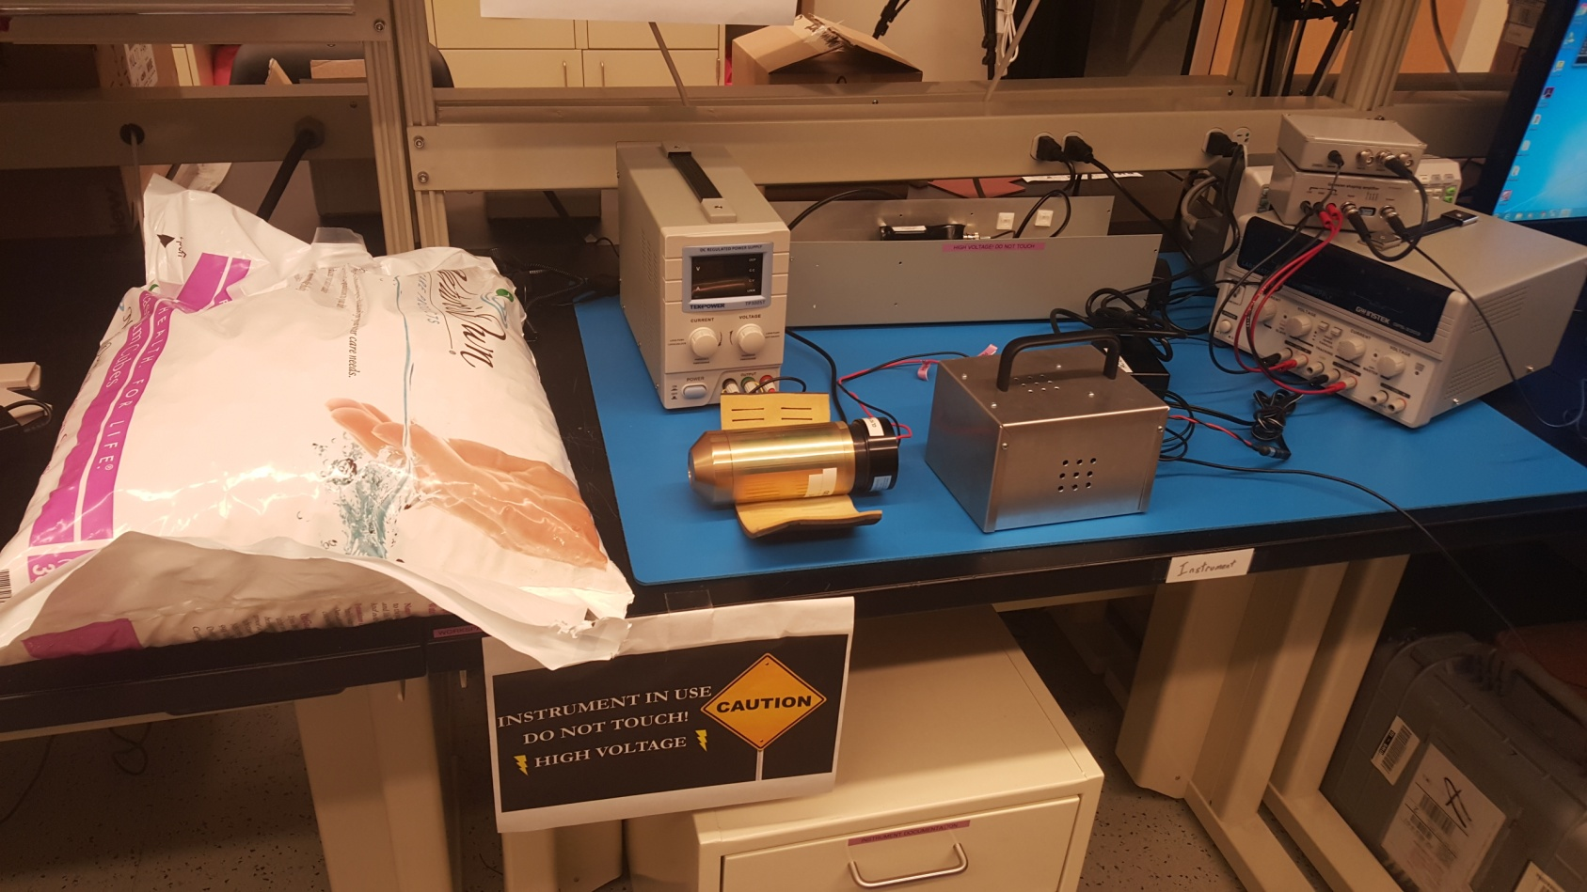
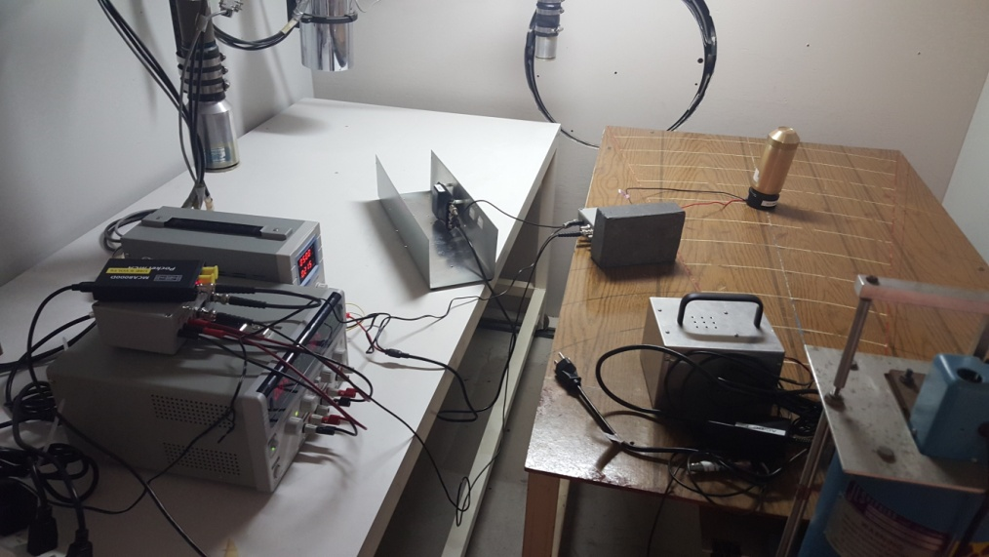
CLYC Laboratory Setup
Hardgrove Lab
Analog Electronics
Digital FGPA
Source: Potassium
Holbert Lab
Analog Electronics
Digital FGPA
Source: Cesium

Slide 6
Signal Processing Hardware
Analog
Charge Sensitive Preamplifier
Gaussian Shaper
Analog/Digital Converter (MCA)
Outputs:
Histogram
Digital
Analog/Digital Converter (MCA)
FPGA and Software Processing
Outputs:
Raw Waveform
Integrals
Histogram
Pulse Shape Discrimination

Slide 7
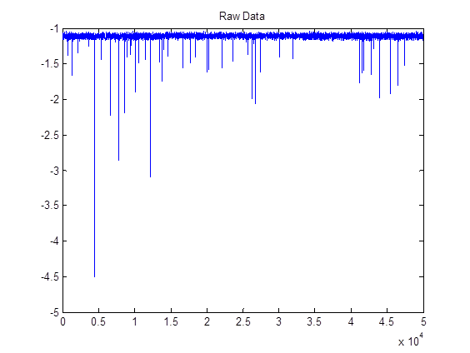
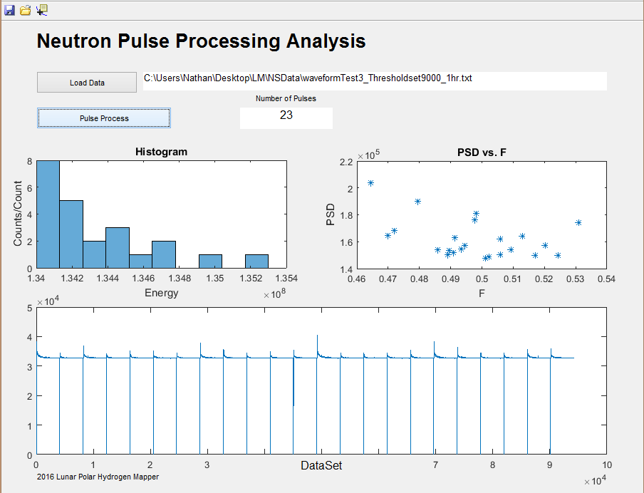
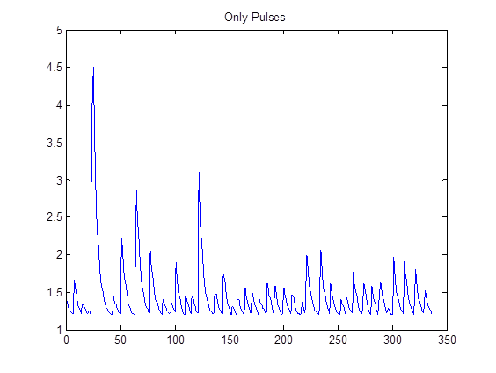
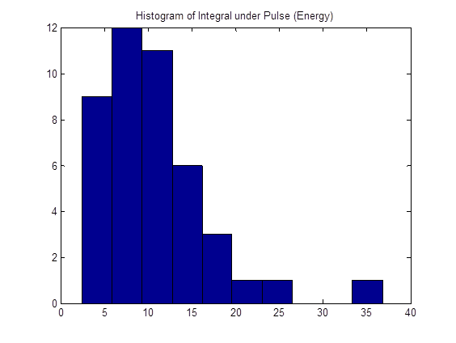
Neutron Pulse Processing Software
Raw Waveform
Convert to Integrals
Generate Histogram

Slide 8
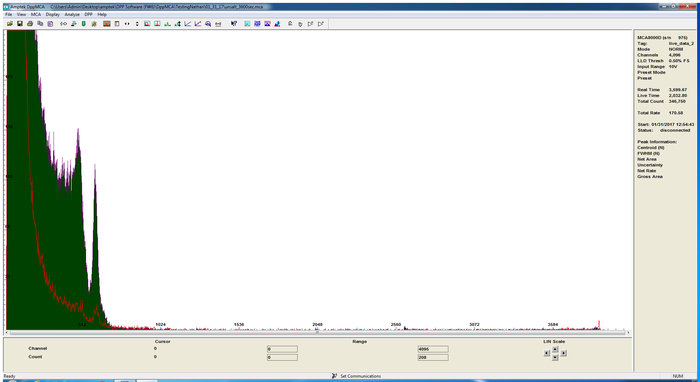
Pulse Processing Results
3600 sec experiment control versus potassium chloride salt pellets
Green: Potassium (K-40) Red: Background radiation

Slide 9
Acknowledgements
Thank you to:
Dr. Craig Hardgrove
Dr. Tom Sharp and Desiree Crawl
Arizona Space Grant Consortium
NASA
Erik Johnson - Radiation Monitoring Devices (RMD)
Dr. Keith Holbert - ASU

Slide 10
Thank you!
Questions??
nathan.barba@asu.edu

